Slide 1
Software Requirement Engineering
CSE-305
Dr Ghulam Rasool

Slide 2
Requirement Validation
Certifies that the requirements document is an acceptable description of the system to be implemented
Checks a requirement document for
Completeness Consistency and Correctness
Conformance to standards
Requirements conflicts
Technical errors
Ambiguous requirements

Slide 3
Requirements Validation
Aim: Check the requirements to certify that they represent an acceptable description of the system which is to be implemented.
Process: It involves stake holders, requirements engineers, and system designers who analyze the requirements for problems, omissions, and ambiguities.

Slide 4
Analysis and Validation
Analysis works with raw requirements as elicited from the system stakeholders
“Have we got the right requirements” is the key question to be answered at this stage
Validation works with a final draft of the requirements document i.e., with negotiated and agreed requirements
“Have we got the requirements right” is the key question to be answered at this stage

Slide 5
Validation Inputs and Outputs
List of problems
Requirements
document
Requirements
Validation
Organizational
knowledge
Agreed actions
Organizational
standards

Slide 6
Importance of Requirement Validation
It cost approximately 100 times more to correct customer reported requirement error than to correct an error during requirement development.
It took an average 30 minutes to fix an error discovered during the requirement phase while it took 5-17 hours to identify same defect during system testing.
In one analysis of 34 safety incidents, “44% had inadequate specification as their primary cause

Slide 7
V Model for Requirement Testing
This model suggests early test planning and test design activities which should begin parallel with development activities. This model shows that:
Acceptance testing is based on user requirements
System testing is based on functional requirements
Integration testing is based on system architecture
Unit testing is based on module design

Slide 8
Requirement Validation Activities
SRS correctly describes the intended system capabilities
Software requirements are correctly derived from system requirements, business rules or other sources
Requirements are complete and are of high quality
Requirement representations are consistent with each other
Requirements provide adequate basis to proceed with design and construction

Slide 9
Requirement Validation Techniques
Reviews
Inspections
Prototyping
User manual development
Model validation
Requirements testing

Slide 10
Reviewing Requirements
Reviewing requirement documents is a technique used for identifying ambiguous or unverifiable requirements. Informal and formal reviews approaches are used for reviewing requirements
Informal reviews are used to educate other peoples about the product and collecting unstructured feedback
Formal reviews follows well defined process and produce report that identifies the material, the reviewers and the judgment of review team. The best type of formal review is the inspection.

Slide 11
Formal Review Process
Distribute
documents
Plan review
Prepare for
review
Hold review
meeting
Follow-up
actions
Revise
documents

Slide 12
Problem Actions
Requirements clarification
The requirement may be badly expressed or may have accidentally omitted information
Missing information
Some information is missing from the requirements document
Requirements conflict
There may be significant conflicts between requirements
Unrealistic requirement
The requirement does not appear to be implement-able with the technology available or given other constraints on the system

Slide 13
Review Checklists(Completeness)
According to Boehm:
To be considered complete, the requirements document must exhibit three fundamental characteristics:
(1) No information is left unstated or “to be determined”,
(2) The information does not contain any undefined objects or entities,
(3) No information is missing from this document.
Research is required to investigate standard metrics for measuring completeness.

Slide 14
Completeness
An individual requirement is complete if it contains all necessary information to avoid ambiguity and need no amplification to enable proper implementation and verification?
Qc = Nu/(Ni * Ns)
where
Nu is the number of unique functions specified in SRS (this count should not contain redundant requirements)
Ni is the count of stimulus input specified in SRS
Ns is the count of state input specified in SRS

Slide 15
Correctness
An SRS is correct if and only if every requirement represents something required of the system to be built
Q = Nc/(Nc + Nnv) = Nc/Nr
where
Nc is the number of correct requirements
Nnv still not validated requirements
Nr total requirements

Slide 16
Unambiguous
A SRS is unambiguous if and only if every requirement stated therein has only one possible interpretation
Q = Nui/Nr
where
Nui is the number of requirements for which all reviewers presented identical interpretations
Nr is total number of requirements

Slide 17
Reading Techniques
Ad-hoc,
Checklist-based,
Defect-based
Pattern based

Slide 18
Ad-hoc reading and checklists
Ad-hoc reading – no guidance is provided, reviewers use only their own knowledge and experience to identify defects.
Checklist-based reading – a list of questions is provided specifying what properties of the document must be checked and what specific problems should be searched for.
Every relevant requirements quality criterion is rewritten in the form of a question, or refined into two or more questions.
A checklist works just as a reminder for reviewers of those quality criteria.

Slide 19
Review Checklists
Consistency
Do the descriptions of different requirements include contradictions? Are there contradictions between individual requirements and overall system requirements?
Example: One part of the requirement say, “all employees who are 65 or older at the end of the calendar year shall receive bonus of 100,000.” Another part say, “all employees with 10 years or more of service at the end of the calendar year shall receive a bonus of Rs. 50,000”.
What about employees who satisfy both conditions?
Organization
Is the document structured in a sensible way? Are the descriptions of requirements organized so that related requirements are grouped?

Slide 20
Review Checklists
Understandability
Can readers of the document understand what the requirements mean?
Redundancy
Is information unnecessarily repeated in the requirements document
Conformance to standards
Does the requirements document and individual requirements conform to defined standards? Are departures from the standards, justified?
Traceability
Are requirements unambiguously identified, include links to related requirements and to the reasons why these requirements have been included?

Slide 21
Checklist Question Quality Attribute
Is each requirements uniquely Traceability, Conformance identified? to Standards
Are Specialized terms defined in Understandability
the glossary
Does a requirements stand on its Understandability completeness own or do you have to examine
other requirements to understand
what it means?
Do individual requirements use the Ambiguity
same term in different ways

Slide 22
Checklist Question Quality Attribute
Is the same service requested in Consistency, redundancy,
different requirements? Are there
any contradictions in these requests?
If a requirement makes reference to Completeness
some other facilities, are these
described elsewhere in the document?
Are related requirements grouped Organization, traceability
together? If not, do they refer to each
other
If temperature is higher than 70 and less than 100, then output should be 3000 watts
Incomplete and inaccurate

Slide 23
Inspection Process
Software inspection can detect almost 50% to 90% defects
Inspection is costly and time consuming
Inspection is a well defined multi-stage process. It involves a small team of trained participants who carefully examine a work product for defects and improvement opportunities.
Participants:
Author of work product and peers of author
Author of any predecessor work product
People who will do work based on the item being inspected
People who are responsible for work products that interface with the items being inspected.

Slide 24
Benefits of Inspection
According to data collected from various studies, the benefits of inspection include the following:
Net increase in productivity in the range of 30-100%
Overall project time saving of 10-30%
5 to 10 times reduction in test execution costs and time
Reduction in maintenance costs of up to one order of magnitude
Improvement in consequent product quality

Slide 25
Inspection Roles
Author
Moderator
Reader
Recorder
Inspectors

Slide 26
Entry Criteria
The entry criteria set some clear expectations for authors to follow while preparing for an inspection.
Following are some suggested entry criteria for requirement document:
Document conform to standard template
Document has been spell-checked
Layout errors are removed
Predecessor or reference documents are attached
Line numbers are printed
All open issues are marked as TBD

Slide 27
Exit Criteria
Inspection process should define the exit criteria that must be satisfied before the moderator declares the inspection complete.
All issues raised during the inspection have been addressed.
Any changes made in the document and related work products were made correctly
The revised document has been spell checked
All TBDs have been resolved

Slide 28
Tools for Inspections
ASSIST
Scrutiny
ICICLE
CSI
WiP
ReviewPro
CheckMate

Slide 29
Requirement Review/Inspection Challenges
Large requirement documents
Large inspection teams
Geographical separation of inspectors
Expensive

Slide 30
Prototyping
Prototypes for requirements validation demonstrate the requirements and help stakeholders discover problems
Validation prototypes should be complete, reasonably efficient and robust. It should be possible to use them in the same way as the required system
User documentation and training should be provided

Slide 31
Prototyping for Validation
Choose
prototype
testers
Develop
test
scenarios
Execute
scenarios
Document
problems
Document and extend prototype system

Slide 32
Prototyping Activities
Choose prototype testers
The best testers are users who are fairly experienced and who are open-minded about the use of new systems. End-users who do different jobs should be involved so that different areas of system functionality will be covered
Develop test scenarios
Careful planning is required to draw up a set of test scenarios which provide broad coverage of the requirements. End-users shouldn’t just play around with the system as this may never exercise critical system features

Slide 33
Prototyping Activities
Execute scenarios
The users of the system work, usually on their own, to try the system by executing the planned scenarios
Document problems
Its usually best to define some kind of electronic or paper problem report form which users fill in when they encounter a problem

Slide 34
User Manual Development
Writing a user manual from the requirements forces a detailed requirements analysis and thus can reveal problems with the document
Information in the user manual
Description of the functionality and how it is implemented
Which parts of the system have not been implemented
How to get out of trouble
How to install and get started with the system

Slide 35
System Models
For some projects, system models may be developed based on the agreed set of requirements
These models may be data-flow models of the system’s functionality, object models, event models, entity-relation models, process models, simulation models etc
Validation of system models is an essential part of the validation process
Some checking is possible with automated tools

Slide 36
Testing Requirements
Research has shown that at least 50% of the total software cost is comprised of testing activities
Test cases that are based on functional requirements or derived from user requirements help make the expected system behaviors tangible to the project participants
Each requirement should have a test case
– How to assess whether the requirement was
successfully implemented
Typically a set of (future) functions in the
code will be tested by a test cases

Slide 37
Test Case Example
The title "Registration Page" shall be left aligned at the top of the page.
The title "Registration Page" is left aligned at the top of the page.
The words "Registration Page" shall be spelled correctly.
The words "Registration Page" are spelled correctly.
The words "Registration Page" shall be in 26 point type.
The words "Registration Page" are in 26 point type
The words "Registration Page" shall be in sans serif type
The words "Registration Page" are in sans serif type

Slide 38
Hard to Test Requirements
System requirements
Requirements which apply to the system as a whole. In general, these are the most difficult requirements to validate irrespective of the method used as they may be influenced by any of the functional requirements.
Exclusive requirements
These are requirements which exclude specific behaviour. For example, a requirement may state that system failures must never corrupt the system database. It is not possible to test such a requirement exhaustively.

Slide 39
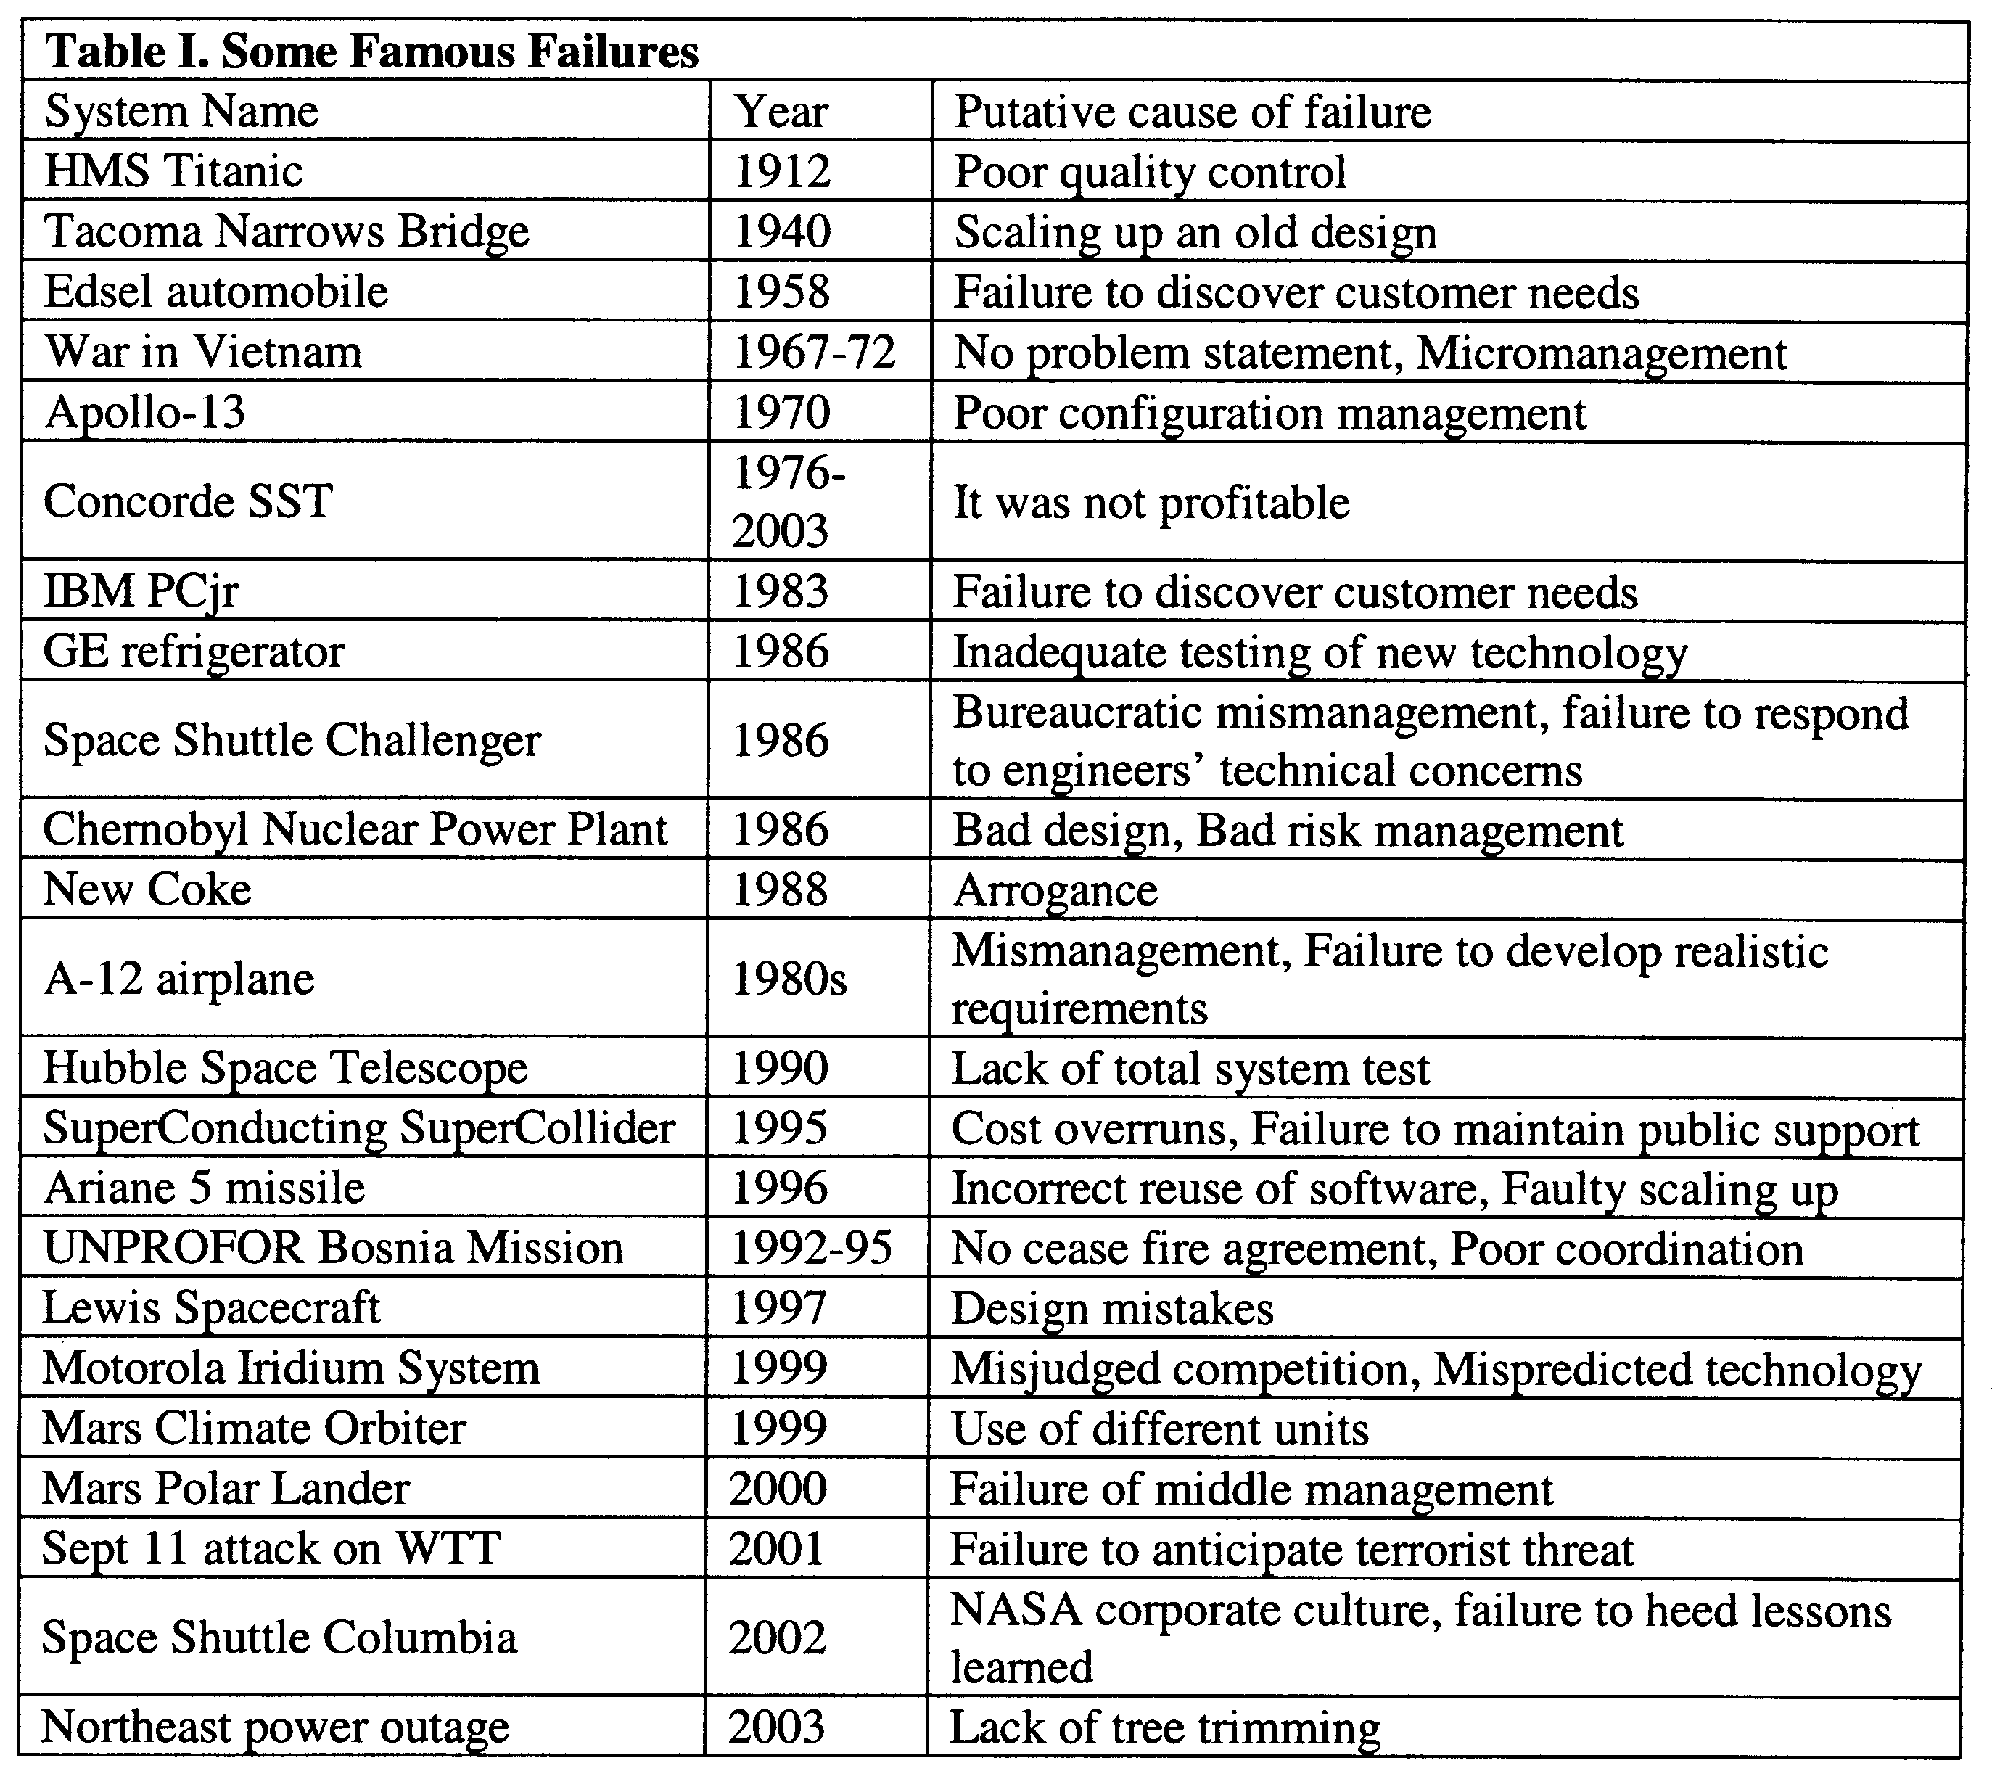
Famous Failures

Slide 40
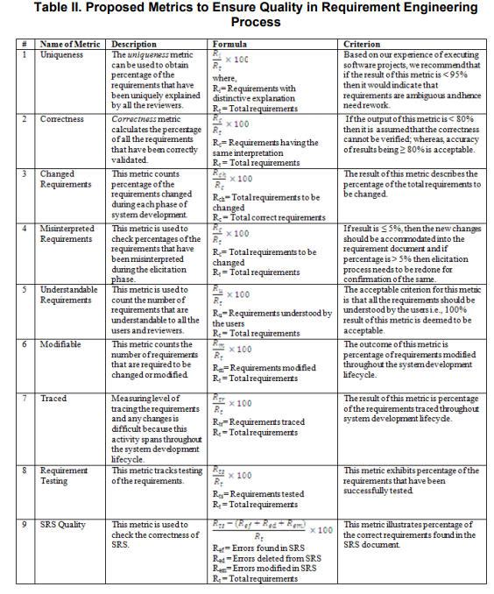
Quality Metrics

Slide 41
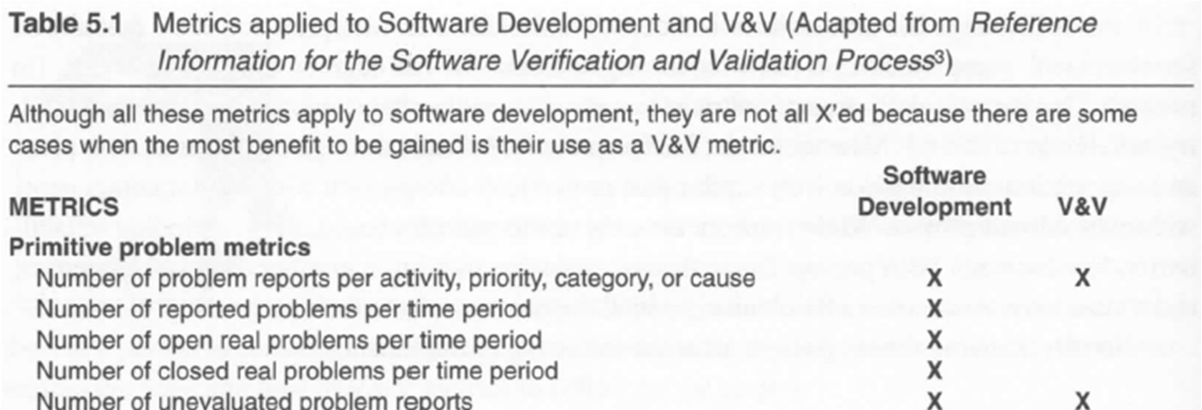
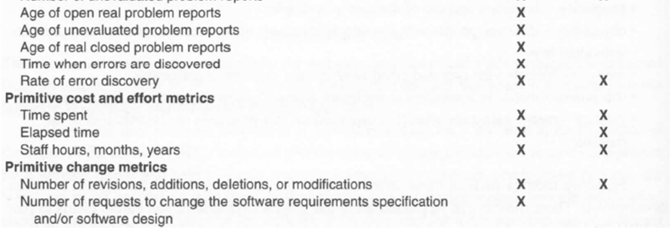
Software Metrics

Slide 42
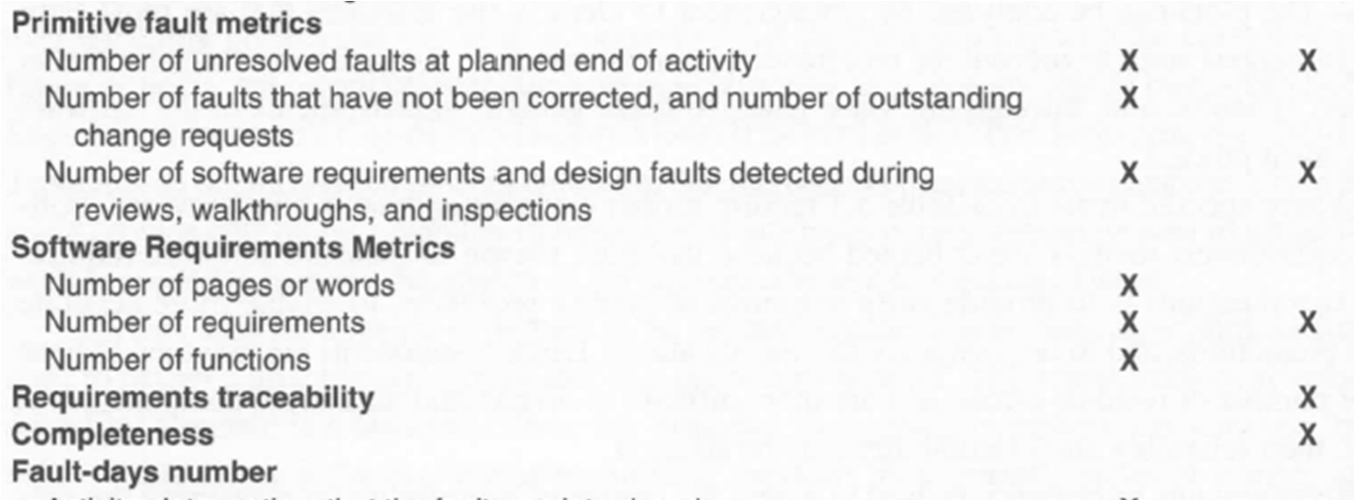
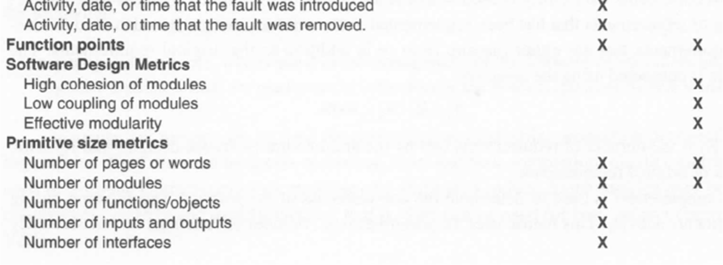
Software Metrics

Slide 43
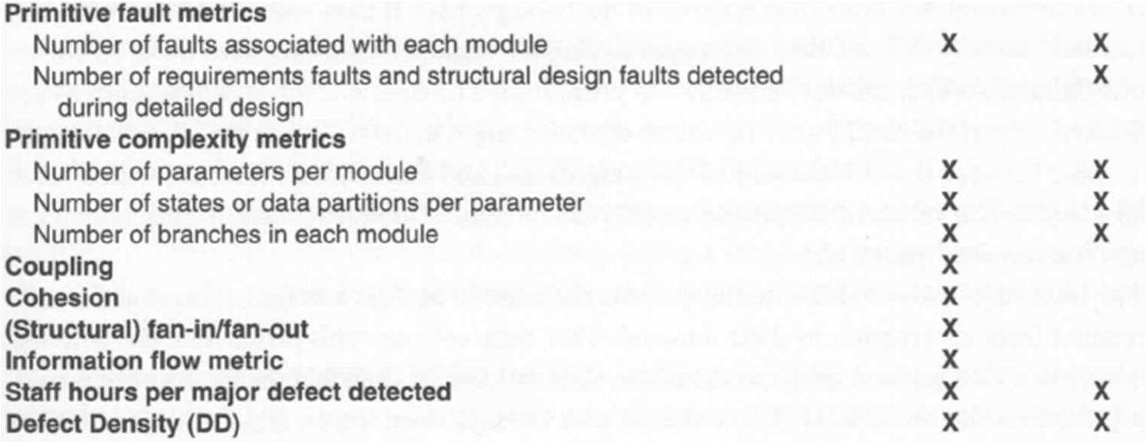
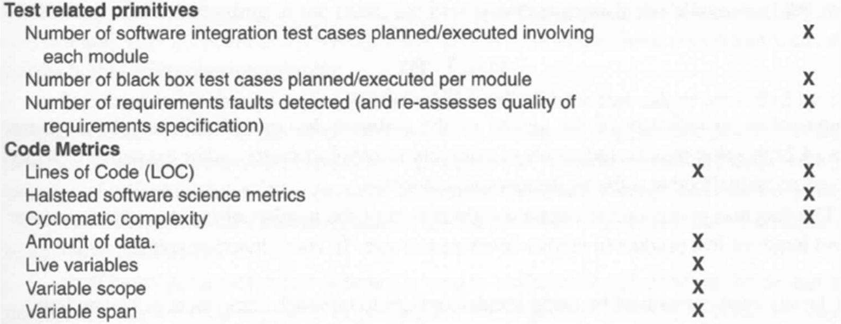
Software Metrics

Slide 44
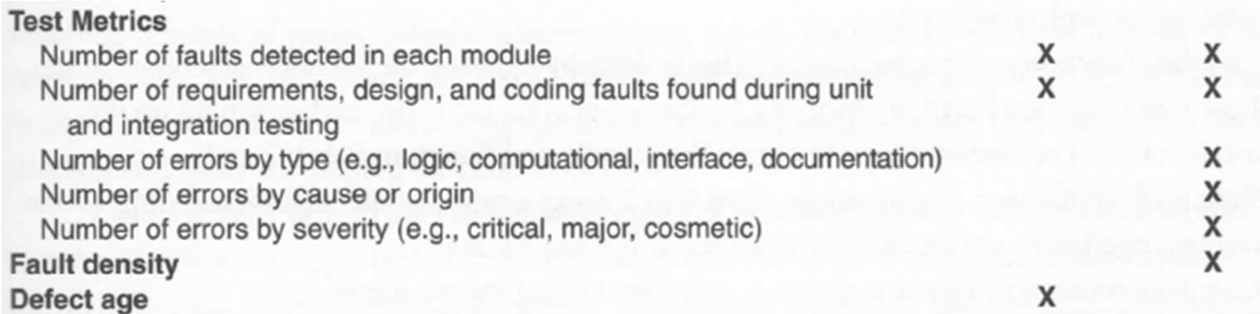
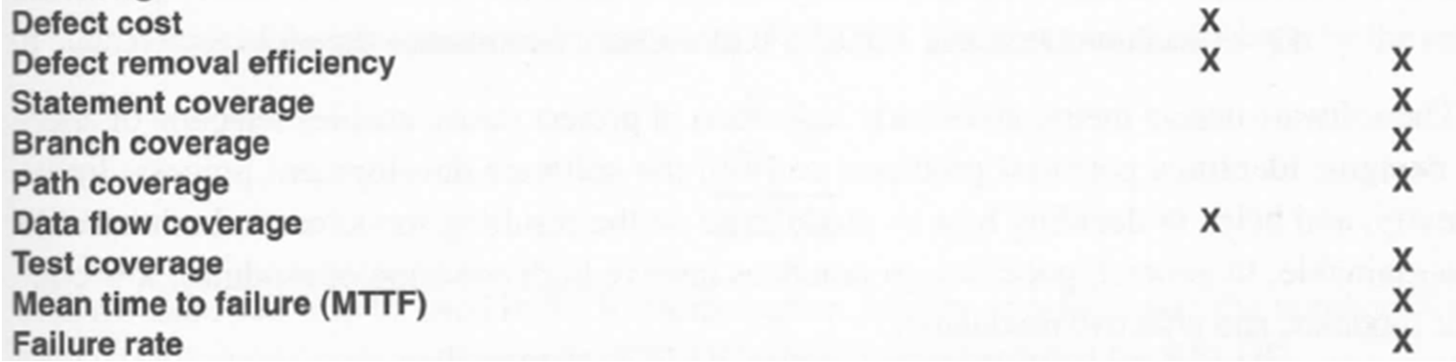
Software Metrics

Slide 45
Sources
System and software requirements validation through inspections: constructive reading and mining requirements from natural language requirements documents
Requirements validation techniques in GSD: A survey
Requirements Development, Verification, and Validation Exhibited in Famous Failures
Requirements Validation Techniques practiced in industry: Studies of six companies
A Systems Engineering Approach to Requirements Validation
A Taxonomy of Verification and Validation of Software Requirement and Specifications

Slide 46
Sources
Donald G. Firesmith: “Are Your Requirements Complete?”, in Journal of Object Technology, vol. 4, no. 1, January-February 2005, pp. 27-43.
Verification and Validation of Modern Software Intensive Systems

